Slide 1
Depression & Mental illness

Slide 2
Facts & Morals
Depression is a common illness worldwide, 3.8% of the population are depressed.
The affected person could suffer greatly and function poorly at work, school, and in the family.
Depression can lead to suicide. Over 700 000 people die due to suicide every year.
Our bot try to provide awareness against depression in order to reduce the world crisis.

Slide 3
DEPRESSION
Lily
FACTORS TO CONSIDER
Lonely
I’m not lonely I just cant get happy!
Childhood trauma
You are so mature for your age
Depressed as a teenager
You have a good music taste
You dont need a reason to be depressed
people pleasing coping mechanism

Slide 4
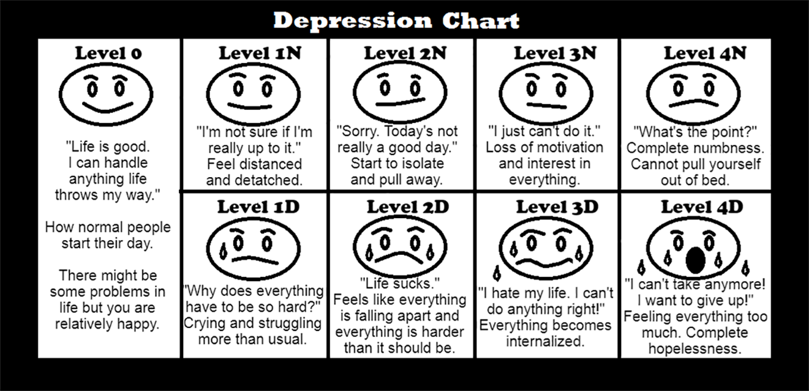


DEPRESSION
Hi
Im Hope
What Should I call you
Mr?

Slide 5
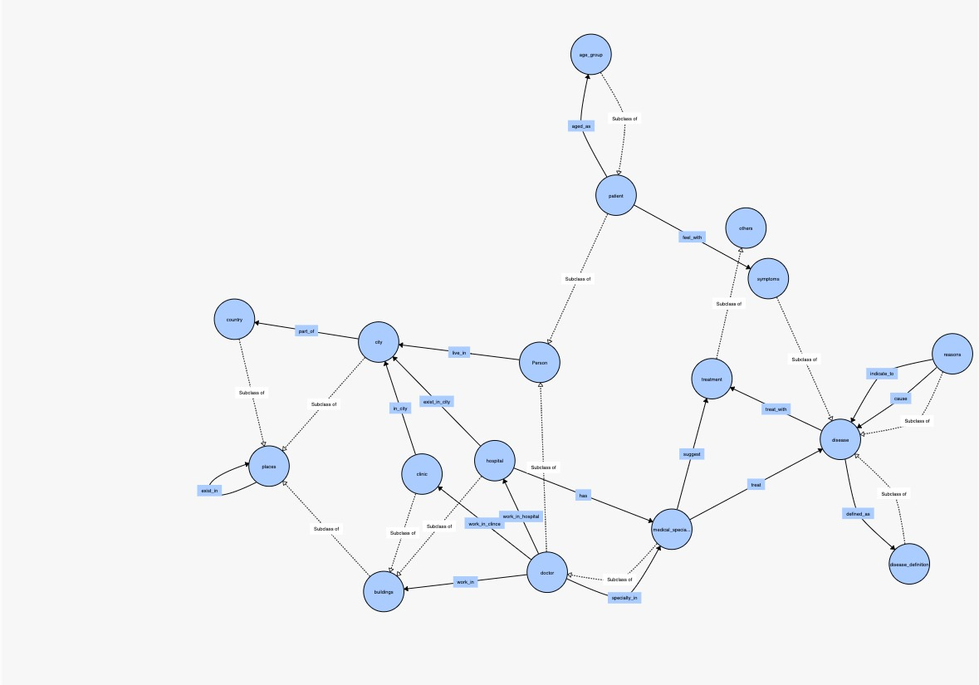
Ontology

Slide 6
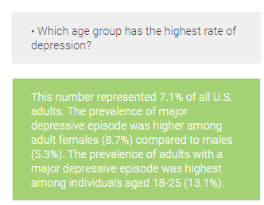
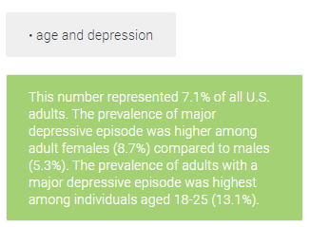
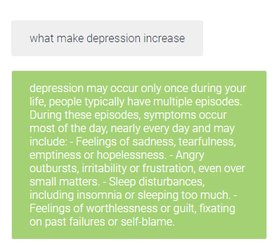
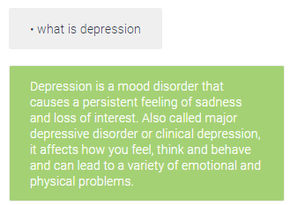
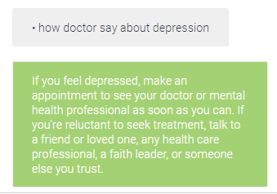
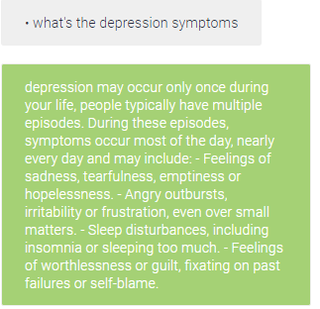
Challenging Questions & synonyms
1-symptoms of depression? Synonyms.
what make depression increase.
what causes depression.
depression reason.
symptoms of depression .
what's the depression symptoms
5- depression and long working hours
Synonyms
depression and long working hours
work and depression
work extra hours
work under pressure work pressure
2-Which age group has the highest rate of depression?
Synonyms
what age group more effected by depression
Which age group has the highest rate of depression?
age and depression
6-Can a lack of sleep cause depression?
Synonyms
Can a lack of sleep cause depression?
how hang at night and sleep in morning effect depression sleep few hours sleep less than 6 hours sleep less than six hours
3-depression?
Synonyms
what is depression
depression
what depression means
how doctors say about depression
depression definition
4- failing_in_life
Synonyms
There is nothing I can do well
I can't do anything right
Nothing I do is right
I definitely will fail in my life
I will never succeed in life

Slide 7
Inability to diagnose the disease, the main goal is to raise awareness against depression. Inability to suggest doctors contacts, or hospitals. The responses depend on the immediate expression, no accumulated knowledge awareness.
Weaknesses

Slide 8

THANKS!
Do you have any questions?
Hope!

